Slide 2
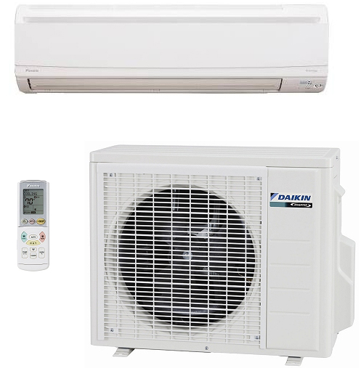
Introduction
Why Ductless?
Overview
Give you the ability to provide a localized heating/cooling solution
Great solution when traditional ducted system would be too costly or difficult to install
Efficiency levels up to 26.1 SEER and 11.0 HSPF
Super quiet operation
Notes:
Ductless mini-split systems give you the ability to provide a localized heating or cooling solution to your customers' comfort needs. Because of their flexible design, mini-splits are great solution when a traditional ducted system would be too costly or difficult to install.

Slide 3
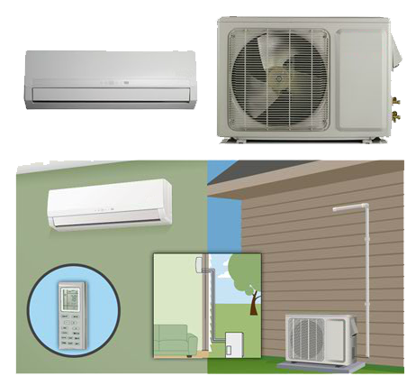
Introduction
Why Ductless?
What is a Ductless Mini-Split?
Small AC or Heat Pump System
  Similar to traditional:
    Condenser
    Evaporator
    Blow
No duct
No thermostat wire
Notes:
Let's start with a quick overview of what exactly a ductless mini-split is. A ductless mini-split is a small air conditioner or heat pump system and is very similar to a traditional system in that it consists of a condenser, evaporator, and blower, but with the mini-split there is no ductwork and there is no thermostat wiring.

Slide 4
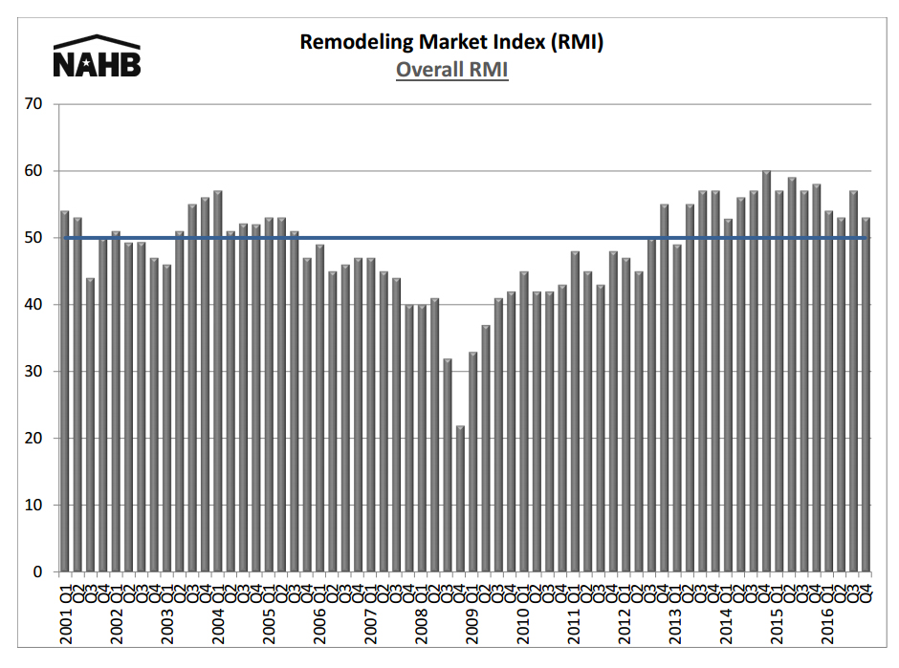
Introduction
Why Ductless?
Why Now?
Notes:
So why is now a good time to add mini-splits to the cooling product lineup? For one thing, in the last few years as the housing market has improved, there has been a steady recent increase in remodeling among homeowners and this trend promises to continue in the near future.

Slide 5



Introduction
Why Ductless?
Applications
Room additions
Sunrooms
Media rooms
Home offices
Upstairs bedrooms
Rooms at end of duct run that don’t heat or cool to desired comfort levels
Notes:
Residential mini-splits offer a simple, affordable, cost-effective, and reliable cooling and heating solution for room additions, but they're also great for specific rooms needing cooling and heat, such as sunrooms, media rooms where extra heat is often generated, home offices, upstairs bedrooms, and rooms at the end of a duct run that don't heat or cool to desired comfort levels.

Slide 6
Features and Benefits for Customers
Why Ductless?
Overview
Sleek design
Easy, flexible installation
Simple operation
Low sound operation
Outstanding energy savings
Security
Notes:
Some of the features and benefits of a mini-split system for your customers include its sleek, attractive design; easy, flexible installation; simple operation; very low sound operation; outstanding energy savings; and security. Let's look at these features and benefits in more detail.

Slide 7
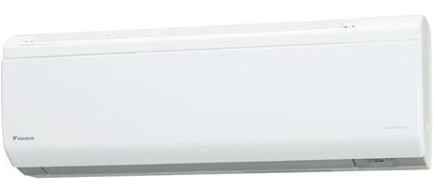
Features and Benefits for Customers
Why Ductless
Sleek Design
Sleek wall/ceiling mount indoor designs blend with any decor
Notes:
A mini-split system features an attractive, sleek design that is contemporary and nonintrusive, blending with any decor. Usually, all LED lights can be turned off so as not to cause disturbances at night or to dark rooms. Indoor units, no matter the type, are designed to blend well into any environment.

Slide 8
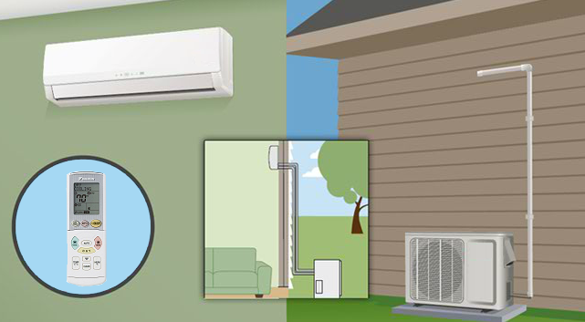
Features and Benefits for Customers
Why Ductless?
Easy Installation
Requires no ductwork or thermostat wire
Notes:
Because no ductwork is required and no thermostat wiring is needed, installation of a mini-split system is quick and easy. Typical mini-split installations only take a few hours to complete, compared to a traditional ducted system that can keep a homeowner at home for a full day or more during installation.

Slide 9


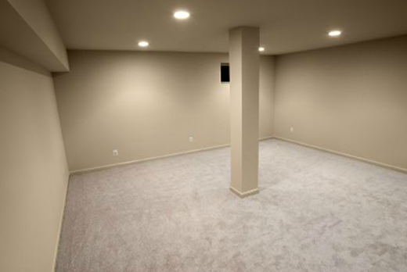
Features and Benefits for Customers
Why Ductless?
Flexible Installation
Flexible installation options solve comfort issues that traditional units sometimes can’t
Notes:
Often homes or rooms were built without full owner comfort in mind. Homes with radiant heat or baseboard heat were built without any provisions to cooling. With sunrooms, there isn't a place to run ductwork even if you wanted to. Many conversions like basements or bonus rooms were left to be conditioned at some later time. A ductless mini-split system is a great comfort solution to all these types of comfort problems and more.

Slide 10
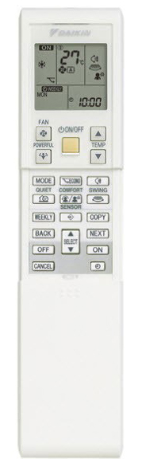
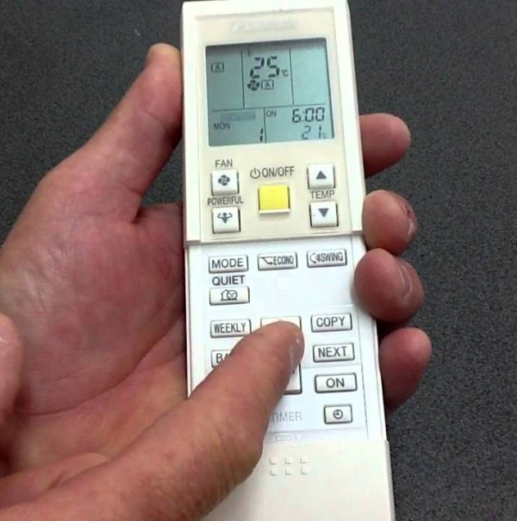
Features and Benefits for Customers
Why Ductless?
Simple Operation
Remote control
Notes:
Operating the mini-split system is simple with an easy-to-use remote control that allows homeowners to effortlessly adjust the temperature to their comfort needs.

Slide 11
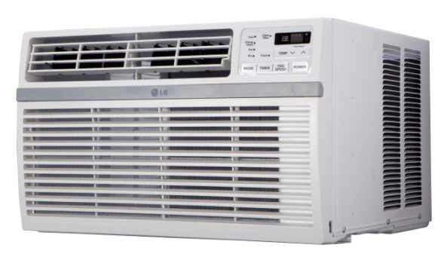
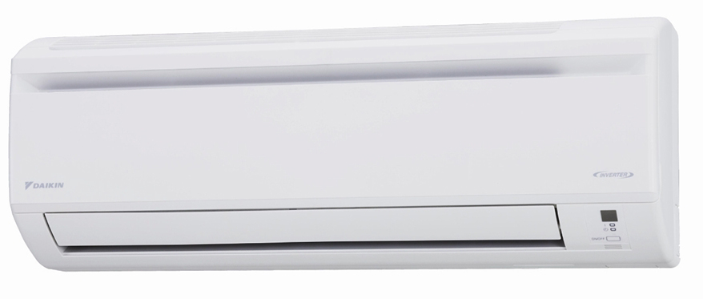
Features and Benefits for Customers
Why Ductless?
Efficient, Precise Comfort
Standard window unit – blasts air at full force
Mini-split system – ramps up to full speed, delivering only the air that’s needed for the desired comfort level
Notes:
Whereas standard window units blast air into a home at full force, a mini-split system uses inverter technology that enables the system to slowly ramp up to full speed, delivering only the air that is needed to achieve the desired comfort level, all while using only minimal energy.

Slide 12
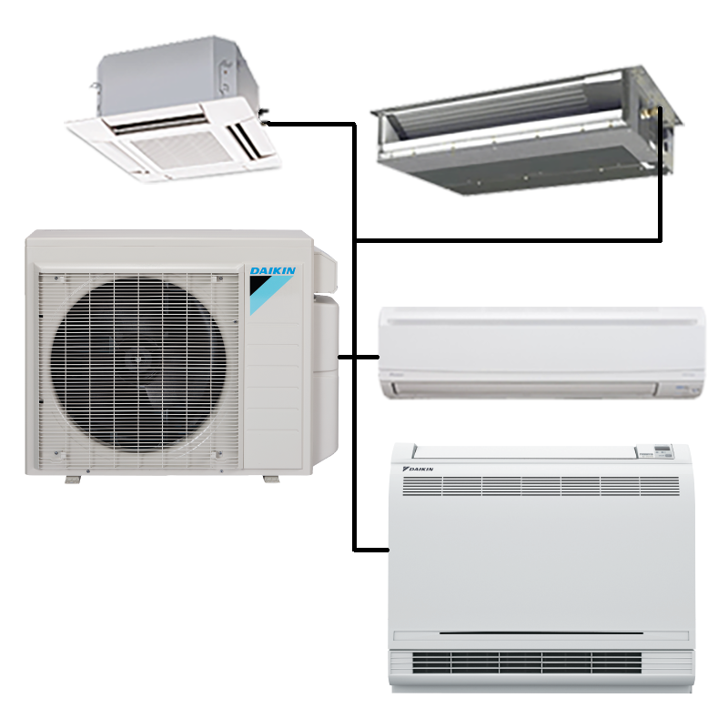
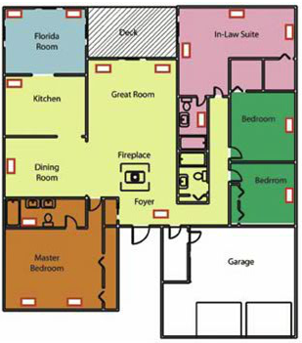
Features and Benefits for Customers
Why Ductless?
Zoning
Condition only the room you are using…
Create your own comfort zone
Notes:
A mini-split system offers a great alternative to traditional zoning. Zoning in a retrofit application can be done, but it can be difficult. A mini-split system allows you to condition only the room you are using, saving the energy that you might've been using to heat or cool the entire home, even the rooms without anyone in them.

Slide 13


Features and Benefits for Customers
Why Ductless?
Quiet
Adjust sound level examples
Low sound operation, down to ____ dbA outdoors and ___dbA indoors
Notes:
A mini-split system is also very quiet. Low sound operation down to **53** DBA for the outdoor unit and **26** DBA for the indoor unit means that the homeowner will barely notice it enhancing the level of comfort.

Slide 14
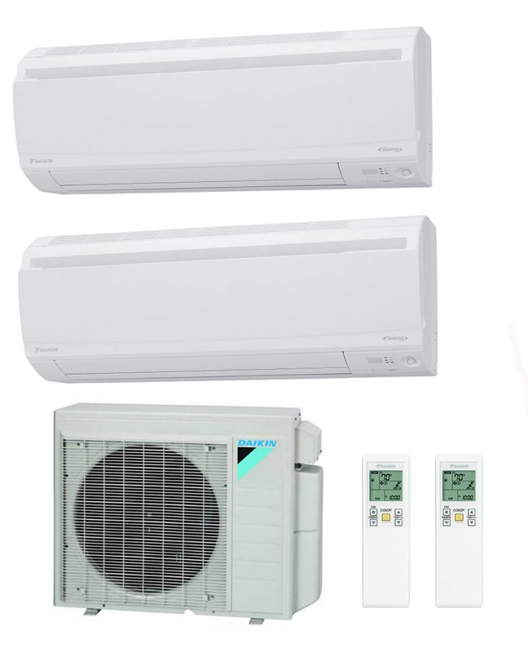


Features and Benefits for Customers
Why Ductless?
Energy Savings
Up to 26.1 SEER and 11.0 HSPF
Energy Star ratings
Possible tax credits / rebate programs
Notes:
Energy efficiency is another important benefit of a mini-split system. Customers can expect to see significant energy savings with units that are rated up to 26.1 seer and 11.0 HSP. Most mini-split systems have also earned the energy star label, having met or exceeded guidelines set forth by the US Environmental Protection Agency. Finally, mini-split systems may be eligible for government tax credits for your customers as well as rebate programs from local utility companies. Advise homeowners to consult their tax advisors for more detailed information.

Slide 15
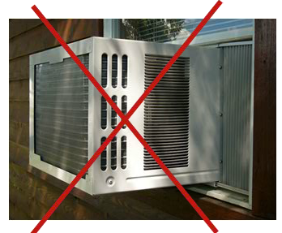
Features and Benefits for Customers
Why Ductless?
Security
Not vulnerable to insects, weather elements, or theft
Notes:
Another advantage of the mini-split system is that unlike window units, a mini-split system does not leave a home vulnerable to insects, weather elements, or theft. Though window units offer convenient cooling, they also offer convenient access for thieves to enter a home, not to mention that window units are historically inefficient and very noisy.

Slide 16
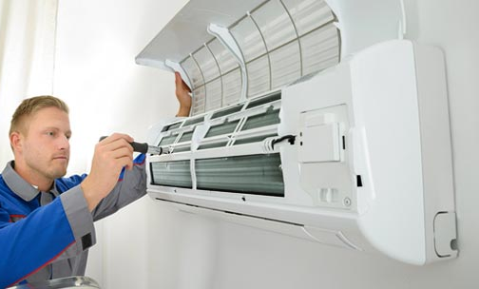
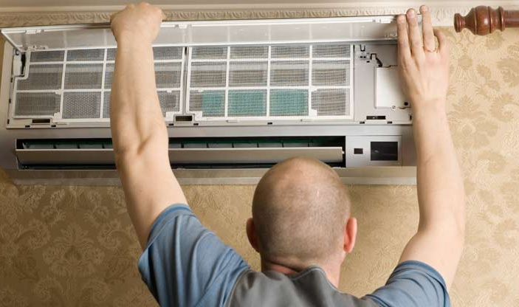
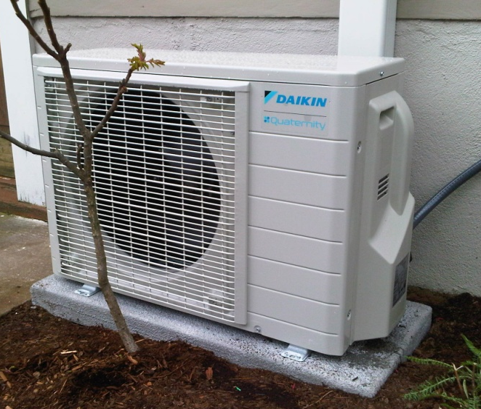
Benefits to You
Why Ductless?
Benefits to Dealer/Installer
Expand offering
Offer another innovative, reliable solution to meet customer needs
Easy to install
Notes:
Selling mini-split systems gives you the opportunity to expand your offerings to your customers. You have a quality, reliable product to solve the unique needs of homeowners whose existing heating and cooling system needs supplementing, and as described earlier, mini-split systems are very easy to install. Since you don't have to worry with thermostat wiring or ductwork, you can set up the system with minimal hassle and complication. In addition to helping you solve many of your customers' comfort problems.

Slide 17

Selling Tips
Why Ductless?
Points to Keep in Mind
Connect the system with the customer’s needs
Explain all the benefits
Critical: Explain in terms the customer will understand
Notes:
When you approach a customer about a mini-split system, of course you want to first connect the benefits of the system with the customer's particular needs, whether they have added onto their home or they have a media room where more heat is generated than the rest of the house, but you want to explain all of the benefits that the system has to offer. However, keep in mind that the more technical benefits may require you to relay the information in terms the customer will understand. The average homeowner will not be familiar with the significance of numbers associated with terms like SEER or dB so it's critical to your selling story to help your customers understand the relevance of the product's benefits.

Slide 18
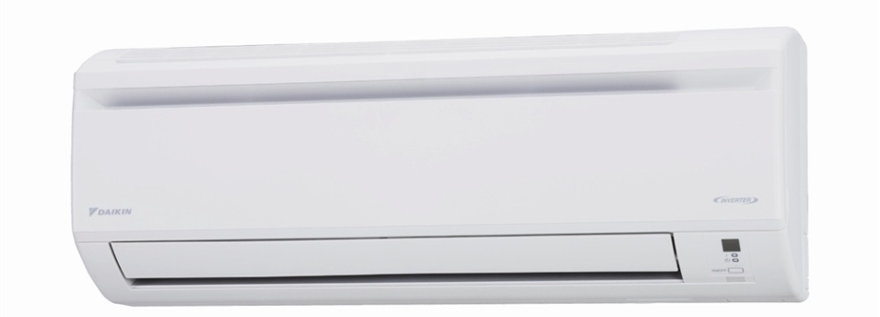

Selling Tips
Why Ductless?
Example – Low Sound Comparison
Whisper = 20 dB
Light rainfall = 30 dB
Mini-split indoor unit = 26 dB
Adjust sound level examples
Notes:
For example, when talking about the low sound levels of the mini-split system, you could explain to the homeowner that a whisper is around 20 dB and light rainfall is 30 dB, so this puts into perspective how quiet the indoor unit is at 26 dB.

Slide 19


Selling Tips
Why Ductless?
Example – Low Sound Comparison
Conversation at kitchen table = 60 dB
Quiet, calm room = 40 dB
Notes:
Here's another great way to relate this to a homeowner: the sound rating of a typical conversation at the kitchen table is 60 DBA and a very quiet calm room is about 40 DBA, so a mini-split indoor unit is much quieter than a library.

Slide 20
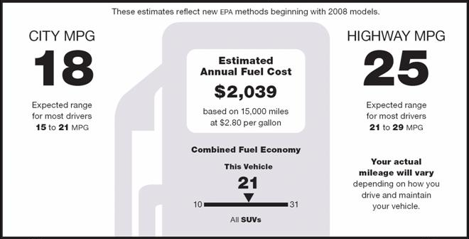
Selling Tips
Why Ductless?
Example – Efficiency Comparison
Compare SEER to MPG
At up to 26.1 SEER, the mini-split AC provides an opportunity for significant savings
Notes:
Here's another example. When discussing energy efficiency, you might compare SEER ratings to miles per gallon. Just as a higher number means you're getting more mileage for your money spent on gas to run the vehicle, a higher SEER number means you're getting more mileage out of the money you spend on that energy to run the air conditioner or heat pump. It would also be helpful to explain to the customer that today the minimum SEER rating on any new air conditioner according to federal regulation is 13, so compared to that at up to 26.1 SEER, the mini-split air conditioner provides an opportunity for significant savings.

