Slide 2
Understanding & Selling IAQ
Understanding & Selling IAQ
Objectives
PHOTO OF SERVICE ADVISOR, MAYBE WITH CUSTOMERS/HOMEOWNERS
In this course, you will learn to:
Understand IAQ issues and solutions
Present customers with IAQ solution options to address their air quality needs
Notes:
In this course, you will learn to:
Understand IAQ issues and solutions
Present customers with IAQ solution options to address their air quality needs

Slide 3

Understanding IAQ
Understanding & Selling IAQ
Introduction
Air in homes and other buildings is becoming increasingly polluted.
Often, indoor air is more polled than outdoor air.
Because many people spend 90% of their time indoors, the chance of being exposed to poor quality air is great.
Notes:
Evidence indicates that the air in homes and other buildings is becoming increasingly polluted. In many cases, evidence suggests that indoor air is more polluted than outdoor air. Since many people spend as much as 90% of their time indoors, the chance of being exposed to poor air for extended periods of time is great. Certain groups of people – e.g., the young, elderly, chronically ill – spend more time indoors than other group and are therefore more susceptible to the effects of indoor air pollution.

Slide 4
Understanding IAQ
Understanding & Selling IAQ
Sources of indoor pollution
Adhesives
Air fresheners
Asbestos floor tiles
Carpets
Cleaning supplies
Fireplaces
Hobby supplies
House dust mites
Household chemicals
Mold
Personal care products
Paneling
Paint supplies
Pesticides
Pet waste
Pet dander and hair
Pet products
Pressed wood furniture
Pressed wood subflooring
Tobacco smoke
Stored fuels
Radon
Notes:
Here (on screen) are just some of the potential sources of indoor air pollution.

Slide 5
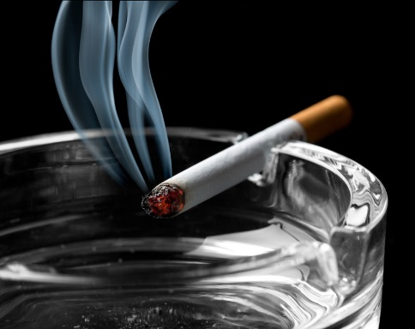
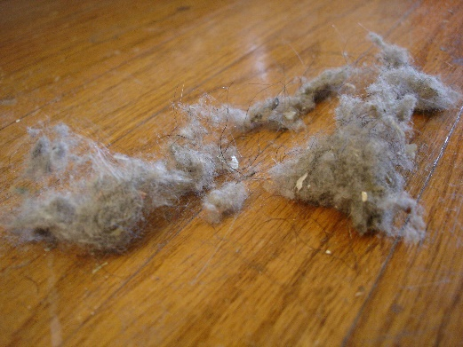
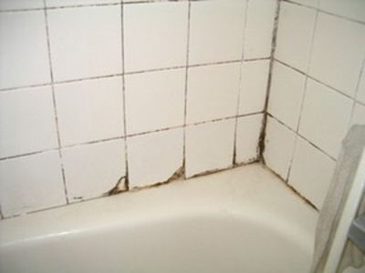
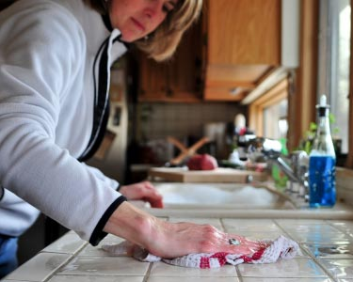
Understanding IAQ
Understanding & Selling IAQ
Common pollutants
Radon
Environmental tobacco smoke
Biological contaminants
Dust mites
Molds
Household products containing organic chemicals
Pesticides
Asbestos
Lead
Notes:
Here are some of the more common household pollutants.
Radon – colorless, odorless, radioactive gas – can lead to lung cancer
Environmental tobacco smoke – environmental tobacco smoke is the mixture of smoke that comes from the end of a cigarette, pipe, or cigar and smoke exhaled by the smoker – consists of over 4000 compounds, more than 40 of which are known to cause cancer and many of which are strong irritants
Biological contaminants -
Dust mites – microscopic spiderlike insects usually found indoors – in warm, humid conditions they thrive and produce waste pellets – they are a primary irritant to people sensitive to dust irritants
Molds – many spores found indoors dome from outside; however, quantities of mold growing indoors can produce many harmful spores; mold is usually found in areas of high humidity; can cause serious problems for those who suffer from disorders such as chronic obstructive pulmonary disease (COPD) or asthma
Household products containing organic chemicals – paints, varnishes, cleaning products, disinfecting products, hobby products, and various fuels contain organic chemicals that are irritants or are otherwise harmful to humans
Pesticides - most disinfectants and kitchen sanitizers contain pesticides
Asbestos – found in older homes and buildings - is a proven carcinogen
Lead -

Slide 6
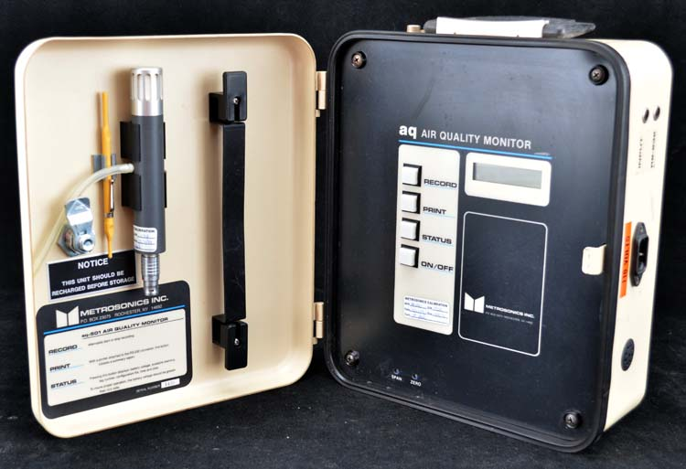
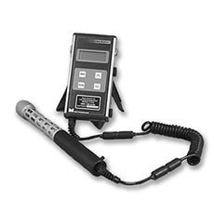
Understanding IAQ
Understanding & Selling IAQ
Monitoring / Elimination / Source control
Some types of contamination can be easily determined; steps can be taken to eliminate the source
Many types of indoor air quality testing and monitoring instruments are available
Carbon dioxide
Carbon monoxide
Hydrogen sulfide
Sulfur dioxide
Chlorine
And others…
Notes:
Some types of contamination can be easily determined; steps can be taken to eliminate the source
Many types of indoor air quality testing and monitoring instruments are available. These can measure things such as
Carbon dioxide
Carbon monoxide
Hydrogen sulfide
Sulfur dioxide
Chlorine
And others…

Slide 7
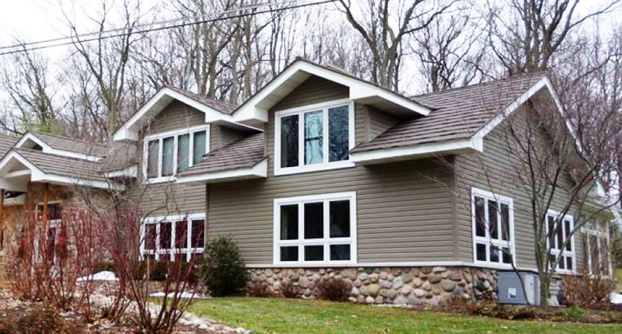
Understanding IAQ
Understanding & Selling IAQ
Ventilation
Most modern homes are designed and constructed more tightly to keep outside air out
This may result in accumulation of pollution inside
Inadequate ventilation may increase the effects of indoor air pollution
Ventilation equipment offsets the negative effects of tight construction
Notes:
Most modern homes and office buildings are designed and constructed more tightly than those in the past to help keep the outside air out in order to maximize the efficiency of heating and cooling systems. However, this may result in accumulation of pollution indoors. Inadequate ventilation can increase the effects of indoor pollution. To offset the negative effects of tight construction, mechanical ventilation may be required.

Slide 8
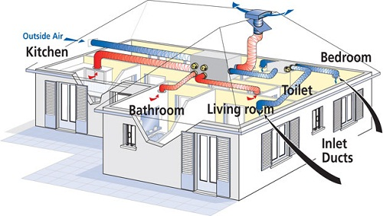
Understanding IAQ
Understanding & Selling IAQ
Ventilation, cont.
Ventilation = process of supplying air by natural or mechanical means
Ventilation air = part of the air supplied from outdoors plus any recirculated air that has been cleaned or treated
Ventilation has a negative effect on the efficiency of heating and cooling systems
Notes:
Ventilation is the process of supplying air by natural or mechanical means to a space. Ventilation air is part of the air supplied from outdoors plus any recirculated air that has been cleaned or treated. Ventilation air should be supplied to the occupants’ breathing space. Indoor air quality can be improved when proper ventilation procedures are followed.
Ventilation has a negative effect on the efficiency of heating and cooling systems. The air that is brought in from the outside must be heated or cooled to maintain the desired temperature in the occupied space.

Slide 9
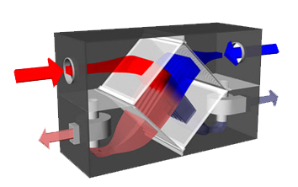
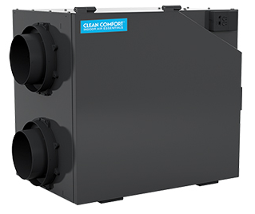
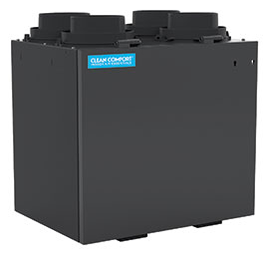
Understanding IAQ
Understanding & Selling IAQ
Ventilation, cont.
Cold, fresh air drawn in from outside
Recovery ventilators supply air to the home and exhaust stale air while recovering energy from the exhaust air, thus reducing negative effects on system efficiency.
HRV (Heat Recovery Ventilator) – transfers heat; used primarily in northern climates where cooling is not a major factor
ERV (Energy Recovery Ventilator) – transfers heat and moisture
Stale, warm air drawn in from bathrooms & kitchen
Cool, stale air from inside is exhausted to the outside
Fresh, heated air sent to living areas & bedrooms
HRV
ERV
Notes:
Energy recovery ventilators are commonly used to reduce the negative effects on system efficiency by transferring heat between the entering and leaving air streams.
Heat Recovery Ventilators (HRVs) transfer heat and are used primarily in northern climates where cooling is not a major factor.
Energy Recovery Ventilators (ERVs) transfer both heat and moisture.

Slide 10
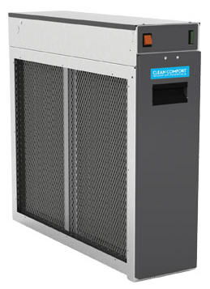
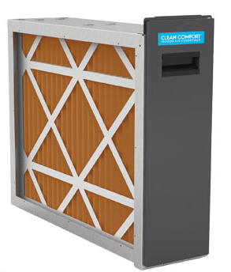
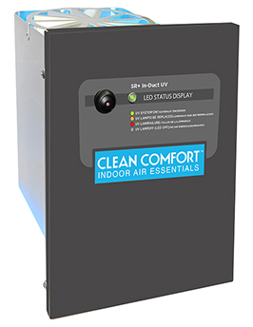
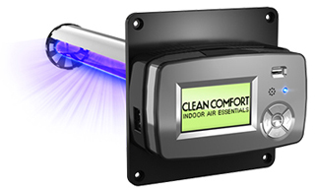
Understanding IAQ
Understanding & Selling IAQ
Filtration / Purification
Types of air cleaners:
Filters
Electronic air cleaners
Ultraviolet (UV) light
“Hybrid” devices contain two or more particle-removing devices
Notes:
Air cleaning, achieved through filtration and/or purification, is another means of improving indoor air quality.

Slide 11
Understanding IAQ
Understanding & Selling IAQ
Filtration / Purification, cont.
HEPA filters
Where highest degree of filtration is desired
Can capture particles down to 0.3 micron – e.g., mold, dust mites, bacteria, pollen, & other allergens
Electrostatic precipitators / electronic air cleaners
Normally have a prefilter section that filters out larger airborne particles and an ionizing or charging section
Electronic air cleaner
Media air cleaner
Notes:
HEPA filters are used where the highest degree of filtration is desired. Many dust particles are in the 20-30 micron size range. Other particles are much smaller and require a much more efficient filter. HEPA filters can capture particles down to 0.3 micron or smaller. These particles can contain mold, dust mites, bacteria, pollen, and other allergens.
Electrostatic precipitators or electronic air cleaners are designed to be mounted (1) at the furnace, (2) within the throwaway filter frame, or (3) within the duct systems. They may also be standalone portable systems. These systems generally have a prefilter section that filters our the larger airborne particles and an ionizing or charging section, where particles are charged with a positive charge. These particles then pass through a negatively charged collection plates.

Slide 12
Understanding IAQ
Understanding & Selling IAQ
Filtration / Purification, cont.
UV/germicidal lights
UV-C light can penetrate the walls of microbes that negatively affect air quality
Damages the DNA of the microbe – kills smaller, weaker ones and prevents larger ones from reproducing
Most effective when used in conjunction with high-efficiency filtration media
UV coil purifier
UV coil purifier for furnaces
Notes:
Purification can be used through the use of ultraviolet (UV) or germicidal lights. UV-C light can penetrate the walls of microbes that negatively affect air quality. Once the light penetrates the microbe walls, the UV-light can damage the DNA of the microbe, killing smaller and weaker ones, and preventing larger ones from reproducing.
UV air treatment systems are most effective when used in conjunction with high-efficiency air filtration media. These units are easily installed in duct systems in much the same way that electric duct heaters are installed.

Slide 13
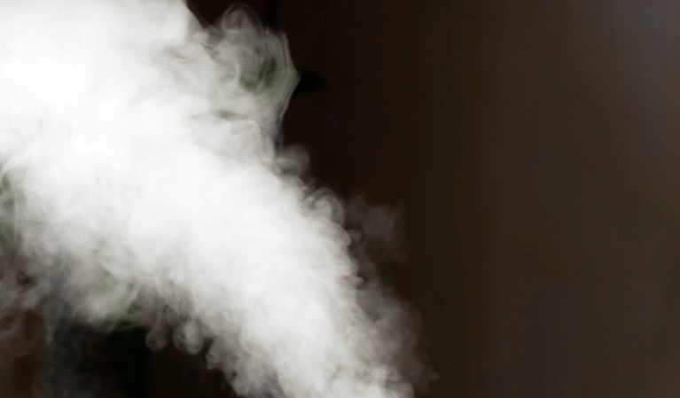
Understanding IAQ
Understanding & Selling IAQ
Humidification / Dehumidification
Humidification
In fall and winter, homes often feel dry
For comfort, “dry” air should be replenished with moisture
Notes:
In fall and winter, homes often feel dry because cold air from the outside infiltrates the conditioned space. The air in the home feels dry when it is heated because it expands, spreading out the moisture. The amount of moisture in the air is often expressed as relative humidity, which is the percentage of moisture in the air compared to the air’s ability to hold moisture. The relative humidity of the air decreases as the temperature increases, because air with higher temperatures can hold more moisture. When a cubic foot of 20F outside air at 50% relative humidity is heated to room temperature (75F), the relative humidity of the air drops.
For comfort, the “dry” air should be replenished with moisture. The recommended relative humidity for a home is between 40% and 60%. Then relative humidity goes above these limits, viruses, fungi, and other organisms become more active.

Slide 14
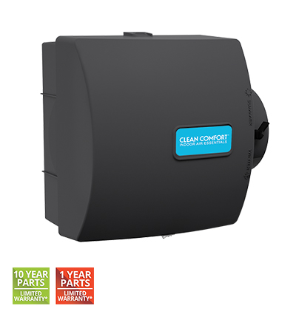
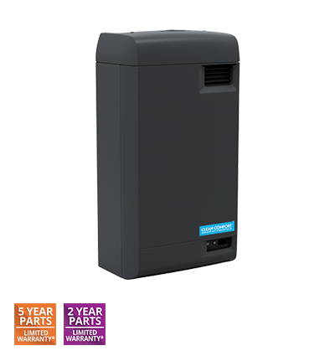
Understanding IAQ
Understanding & Selling IAQ
Humidification / Dehumidification, cont.
Bypass evaporative humidifiers
Rely on the difference in pressure between the supply (warm) side of the furnace and the return (cool) side
Difference in pressure between the plenums drawn some heated air through the humidifier to the return duct
Steam humidifiers
Heat water internally to create steam
Steam injected into ductwork
Evaporative
humidifier
Steam
humidifier
Notes:
Evaporative humidifiers work on the principle of providing moisture to a surface called a medium and exposing it to the dry air. This is normally done by forcing the air through or around the medium; the air picks up the moisture from the medium as a vapor or a gas. There are several types of evaporative humidifiers.
Bypass humidifiers rely on the difference in pressure between the supply (warm) side of the furnace and the return (cool) side. It may be mounted either on the supply plenum or duct or the cold air return plenum or duct. Piping must be run from the plenum or duct where the humidifier is mounted to the other plenum or duct. If mounted in the supply duct, piping must be run to the cold air return. The difference in pressure between the two plenums draws some heated air through the humidifier to the return duct.
Steam humidifiers heat water internally to create steam. This steam is then injected into the ductwork to add moisture to the air stream.

Slide 15
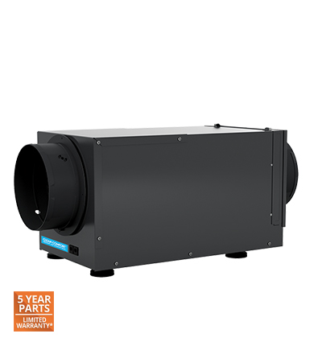
Understanding IAQ
Understanding & Selling IAQ
Humidification / Dehumidification, cont.
Dehumidification
Removes moisture from the air
Most useful in spring and fall
Dehumidifiers
Help maintain comfortable environment
Some may clean air as well as dehumidify
Can keep home furnishings from being damaged by overly moist air
Notes:
As mentioned earlier, if relative humidity goes above 60%, viruses, fungi, and other organisms become more active. Also, greater humidity can cause damage to household furnishings.
Dehumidifiers help improve air quality by removing moisture from the air. They are most useful in the fall and spring, when air is more likely to be more humid.
Dehumidifiers help maintain a comfortable environment, and some are designed to clean air as well as dehumidify.

Slide 16
Selling IAQ
Understanding & Selling IAQ
6-step selling process
Educate your customer
Assess IAQ in the home
Identify the IAQ issues
Present recommendations
Install equipment
Validate customer’s decisions
PHOTO OF SERVICE ADVISOR WITH CUSTOMERS/HOMEOWNERS
Notes:
There is a 6-step selling process that you can follow to help you sell IAQ solutions to meet your customers’ needs.
This steps in this process are:
Educate your customer
Assess IAQ in the home
Identify the IAQ issues
Present recommendations
Install equipment
Validate customer’s decisions
Let’s look at each step in detail.

Slide 17

Selling IAQ
Understanding & Selling IAQ
Educate your customer
Explain types of contaminants found in the home
Explain impact of IAQ on health, comfort, & cleanliness
Explain strategies for improving indoor air – monitoring / elimination / source control; ventilation; filtration / purification; humidity control
Explain the role IAQ plays in complete and continuous indoor comfort
Explain “whole home” comfort to demonstrate that IAQ is as important as heating and cooling
Explain how HVAC equipment contributes to the complete and continuous comfort of a home
Notes:
The first step is to EDUCATE YOUR CUSTOMER about Indoor Air Quality.
In communicating with your customer, you need to:
Explain types of contaminants found in the home
Explain impact of IAQ on health, comfort, & cleanliness
Explain strategies for improving indoor air – monitoring / elimination / source control; ventilation; filtration / purification; humidity control
Explain the role IAQ plays in complete and continuous indoor comfort
Explain “whole home” comfort to demonstrate that IAQ is as important as heating and cooling
Explain how HVAC equipment contributes to the complete and continuous comfort of a home

Slide 18
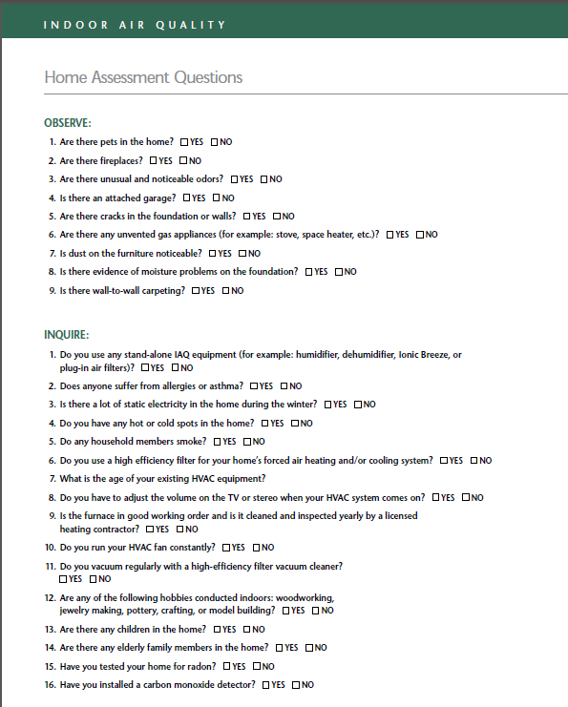
Selling IAQ
Understanding & Selling IAQ
IAQ Home Assessment
Use an IAQ home assessment survey to determine possible sources of indoor air contamination and to see what equipment exists in the home
Encourage customers to identify:
Health concerns (e.g., asthma/allergy sufferers)
Home comfort concerns (e.g., humidity, noise)
Home cleanliness concerns (e.g., dust, pet dander)
Notes:
Next, you’ll want to do an IAQ HOME ASSESSMENT.
One way to do this is to use an IAQ home assessment survey to determine possible sources of indoor air contamination and to see what equipment exists in the home
Encourage customers to identify:
Health concerns (e.g., asthma/allergy sufferers)
Home comfort concerns (e.g., humidity, noise)
Home cleanliness concerns (e.g., dust, pet dander)

Slide 19

Selling IAQ
Understanding & Selling IAQ
IAQ Home Assessment, cont.
Identify customers’ buying motives
Comfort and pleasure – enjoyment, good health, comfort, cleanliness
Avoidance of pain – less work, less time, safety, good health, relief from discomfort
Love and affection – family, security of loved ones, health of loved ones
Fear of loss – prevent loss, save time, save money, protect health of loved ones
Notes:
Next, you’ll want to identify your customers’ busying motives. These could include:
Comfort and pleasure – enjoyment, good health, comfort, cleanliness
Avoidance of pain – less work, less time, safety, good health, relief from discomfort
Love and affection – family, security of loved ones, health of loved ones
Fear of loss – prevent loss, save time, save money, protect health of loved ones

Slide 20

Selling IAQ
Understanding & Selling IAQ
IAQ Home Assessment, cont.
Add value to your service, setting you apart from the competition.
Set the buying criteria of your customer
Set a standard by which all competition will be judged
Reinforce the complete and continuous comfort approach
Justify your solution’s cost, not your equipment’s price
Notes:
As you communicate with the customer, you want to add value to your service, setting yourself apart from the competition. This includes:
Set the buying criteria of your customer
Set a standard by which all competition will be judged
Reinforce the complete and continuous comfort approach
Justify your solution’s cost, not your equipment’s price

Slide 21
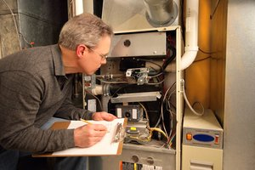
Selling IAQ
Understanding & Selling IAQ
IAQ Home Assessment, cont.
Observe and inspect the home.
Inspect the existing HVAC system.
Age of existing equipment
Efficiency rating of existing equipment
Duct leakage
Accessories (upgraded t-stats, filtration, zoning, humidifiers, etc.)
Notes:
The next steps in the IAQ Home Assessment are to:
Observe and inspect the home.
Inspect the existing HVAC system.
Age of existing equipment
Efficiency rating of existing equipment
Duct leakage
Accessories (upgraded t-stats, filtration, zoning, humidifiers, etc.)

Slide 22

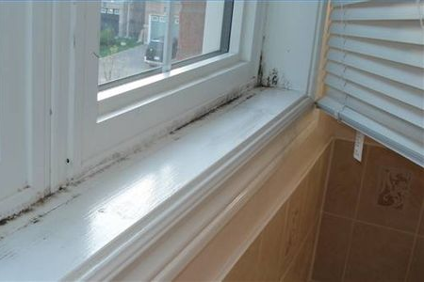
Selling IAQ
Understanding & Selling IAQ
Identify IAQ issues
Analyze assessments to determine types of issues
Health issues
Allergy and asthma sufferers
Pets
Odors / chemical vapors
Particulates (pollen, dust, dirt)
Bio-aerosols (mold spores, bacteria, fungi, viruses)
Comfort issues
Humidity
Inconsistent temperatures (hot / cold spots)
System short cycling
Noise, efficiency, reliability
Notes:
Next, you’ll want to IDENTIFY IAQ ISSUES.
Analyze assessments to determine types of issues
Health issues
Allergy and asthma sufferers
Pets
Odors / chemical vapors
Particulates (pollen, dust, dirt)
Bio-aerosols (mold spores, bacteria, fungi, viruses)
Comfort issues
Humidity
Inconsistent temperatures (hot / cold spots)
System short cycling
Noise, efficiency, reliability

Slide 23
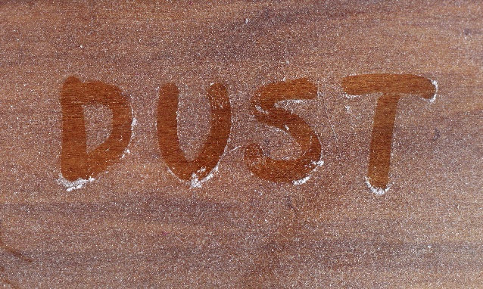
Selling IAQ
Understanding & Selling IAQ
Identify IAQ issues, cont.
Cleanliness issues
Dust, dirt
Mold, mildew
Stale, musty odors
Notes:
(continuing)
Cleanliness issues
Dust, dirt
Mold, mildew
Stale, musty odors

Slide 24

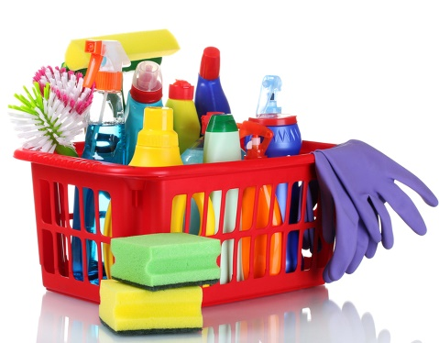
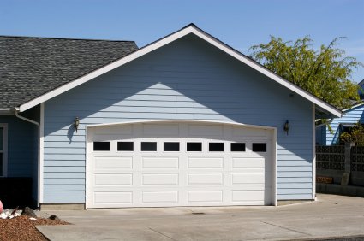
Selling IAQ
Understanding & Selling IAQ
Identify IAQ issues, cont.
Determine sources of contamination
Duct leakage
Pets
Cleaning supplies or other household chemicals
Attached garage
Lifestyle
Improperly installed and/or improperly sized equipment
Notes:
The next step in Identifying IAQ Issues is to determine sources of contamination, which could include:
Duct leakage
Pets
Cleaning supplies or other household chemicals
Attached garage
Lifestyle
Improperly installed and/or improperly sized equipment
Next, let’s take a look at 4 example scenarios and how you might approach each one from an IAQ perspective.

Slide 25

Selling IAQ
Understanding & Selling IAQ
Identifying the need – Scenario 1: Pet odor
Upon entering the home, you notice a lingering pet odor; you see there’s a family dog.
Tactfully inform customer that lingering pet odors can cause health problems in addition to discomfort.
Make it about comfort and health.
Ask customer-benefit questions, such as:
“Is anyone in the house allergic to pet odors or volatile organic compounds?”
Notes:
Scenario 1: Pet Odor
Upon entering the home, you notice a lingering pet odor; you see there’s a family dog.
Tactfully inform customer that lingering pet odors can cause health problems in addition to discomfort.
Make it about comfort and health.
Ask customer-benefit questions, such as:
Is anyone in the house allergic to pet odors or volatile organic compounds?

Slide 26
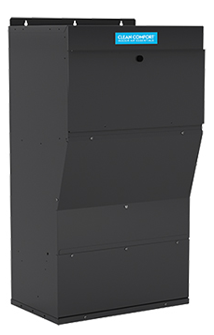
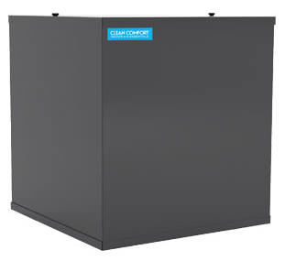
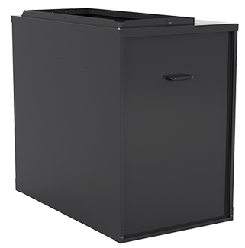
Selling IAQ
Understanding & Selling IAQ
Identifying the need – Scenario 1: Pet odor, cont.
Identify the solution…
BEST
BETTER
GOOD
Clean Comfort AMHP 5-Stage Air Treatment
Clean Comfort ERV/HRV
Clean Comfort AMHP HEPA Air Cleaner
Clean Comfort ERV/HRV
Clean Comfort AM Media Air Cleaner
Notes:
NOTE: These are suggestions – modify as desired.

Slide 27

Selling IAQ
Understanding & Selling IAQ
Identifying the need – Scenario 2: Dry air
In the customer’s home, you see wood floors, indoor plants, & a piano.
Educate the customer that dry air results in health problems, causes wood to split, affects the health of indoor plants, and impacts tuning of musical instruments.
Suggested questions you could ask:
“Does anyone get sinus infections?”
“Does anyone have dry sinuses? Dry skin?”
“Ever notice static electricity?”
Notes:
Scenario 2: Dry Air
In the customer’s home, you see wood floors, indoor plants, & a piano.
Educate the customer that dry air results in health problems, causes wood to split, affects the health of indoor plants, and impacts tuning of musical instruments.
Suggested questions you could ask:
“Does anyone get sinus infections?”
“Does anyone have dry sinuses? Dry skin?”
“Ever notice static electricity?”

Slide 28
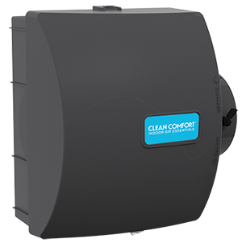
Selling IAQ
Understanding & Selling IAQ
Identifying the need – Scenario 2: Dry air, cont.
Identify the solution…
BEST
BETTER
GOOD
Clean Comfort Steam Humidifier
Clean Comfort ERV/HRV
Clean Comfort bypass Evaporative Humidifier w/ automatic control
Clean Comfort bypass Evaporative Humidifier w/ manual control
Notes:
NOTE: These are suggestions – modify as desired.

Slide 29
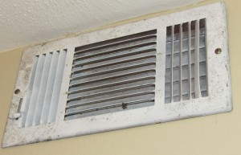
Selling IAQ
Understanding & Selling IAQ
Identifying the need – Scenario 3: High humidity
In the customer’s home, you see mildew around the registers, notice the air is clammy, and see the thermostat is set below 70 degrees.
Educate the customer on the adverse effects of mold, mildew, and other contaminants that grow in humid conditions.
Directly address your observations:
“Are you aware of the mildew on your registers?”
“These conditions are ideal for contaminant growth.”
Notes:
Scenario 3: High Humidity
In the customer’s home, you see mildew around the registers, notice the air is clammy, and see the thermostat is set below 70 degrees.
Educate the customer on the adverse effects of mold, mildew, and other contaminants that grow in humid conditions.
Directly address your observations:
“Are you aware of the mildew on your registers?”
“These conditions are ideal for contaminant growth.”

Slide 30
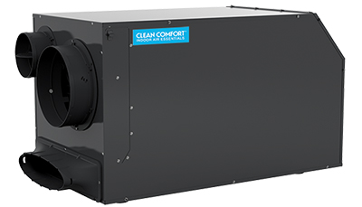
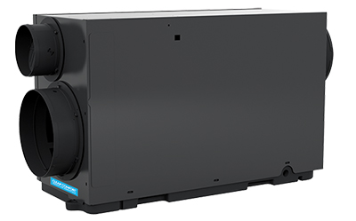
Selling IAQ
Understanding & Selling IAQ
Identifying the need – Scenario 3: High humidity, cont.
Identify the solution…
BEST
BETTER
GOOD
Clean Comfort DV070 Dehumidifier
Clean Comfort DV098 Dehumidifier
Clean Comfort DV155 Dehumidifier
Notes:
NOTE: These are suggestions – modify as desired.

Slide 31
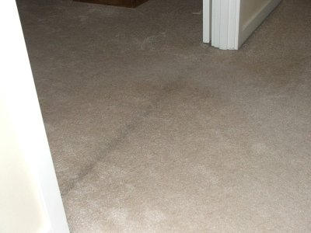
Selling IAQ
Understanding & Selling IAQ
Identifying the need – Scenario 4: Dust
As you walk through the home, you notice dust on the TV and furniture, black streaks under internal doorways, and a negative draft.
Show the customer your findings.
Questions:
“Do you notice that you have to dust frequently?”
“Is anyone in the house allergic to dust?”
“Have you ever noticed these streaks under your doors?”
Notes:
Scenario 4: Dust
As you walk through the home, you notice dust on the TV and furniture, black streaks under internal doorways, and a negative draft.
Show the customer your findings.
Questions:
“Do you notice that you have to dust frequently?”
“Is anyone in the house allergic to dust?”
“Have you ever noticed these streaks under your doors?”

Slide 32
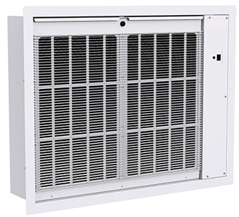
Selling IAQ
Understanding & Selling IAQ
Identifying the need – Scenario 4: Dust, cont.
Identify the solution…
BEST
BETTER
GOOD
Clean Comfort AMHP 5-Stage Air Treatment
Clean Comfort AMHP Electronic Air Cleaner
Clean Comfort AM Media Air Cleaner
Notes:
NOTE: These are suggestions – modify as desired.

Slide 33
Selling IAQ
Understanding & Selling IAQ
Present recommendations
Make a professional presentation of your recommendations
Present your company’s qualifications
Review your customers’ concerns – allow them to sell themselves on your solutions
Present your solutions
Present the cost of your solutions with confidence, knowing your solutions are of great benefit to your customers
Offer a scheduled maintenance programs as part of your proposal
Request approval to schedule the installation – ASK FOR THE SALE!
PHOTO OF SERVICE ADVISOR WITH CUSTOMERS/HOMEOWNERS
Notes:
The next step in the selling process is to PRESENT RECOMMENDATIONS.
Make a professional presentation of your recommendations
Present your company’s qualifications
Review your customers’ concerns – allow them to sell themselves on your solutions
Present your solutions
Present the cost of your solutions with confidence, knowing your solutions are of great benefit to your customers
Offer a scheduled maintenance programs as part of your proposal
Request approval to schedule the installation – ASK FOR THE SALE!

Slide 34
Selling IAQ
Understanding & Selling IAQ
Install equipment
Discuss the installation with your team and your customer
Explain the customer’s concerns and provide background on your customer
Coordinate installation
Confirm installation plans
Confirm installation date with your customer
Confirm installation date with your team
Complete the installation
PHOTO OF SERVICE ADVISOR WITH CUSTOMERS/HOMEOWNERS
EXCEED your customer’s expectations!
Doing so will justify your price exceeding that of your competitors.
Notes:
The next step is to INSTALL THE EQUIPMENT.
Discuss the installation with your team and your customer
Explain the customer’s concerns and provide background on your customer
Coordinate installation
Confirm installation plans
Confirm installation date with your customer
Confirm installation date with your team
Complete the installation
Your overarching concern should be to EXCEED YOUR CUSTOMER’S EXPECTATIONS.
Doing so will justify your price exceeding that of your competitors.

Slide 35

Selling IAQ
Understanding & Selling IAQ
Validate your customer’s purchase decisions
Thank your customers for buying your solutions!
Send a “Thank You” card and let your customer know you are always available to answer questions or offer advice
Offer a “Preferred Customer” discount for preventive maintenance of the newly installed equipment
Send customer reminders for maintenance 9 to 11 months after install (e.g., filters, UV lights)
Notes:
Finally, you’ll want to VALIDATE YOUR CUSTOMER’S PURCHASE DECISION.
Thank your customers for buying your solutions!
Send a “Thank You” card and let your customer know you are always available to answer questions or offer advice
Offer a “Preferred Customer” discount for preventive maintenance of the newly installed equipment
Send customer reminders for maintenance 9 to 11 months after install (e.g., filters, UV lights)

