Slide 1
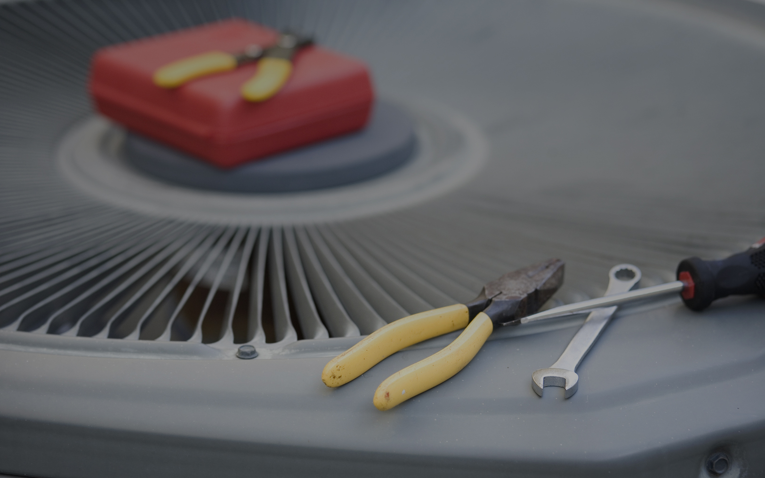


Power Your Career
Ductless Service

Slide 2
Objectives
Ductless Troubleshooting & Service
How to….

Slide 3
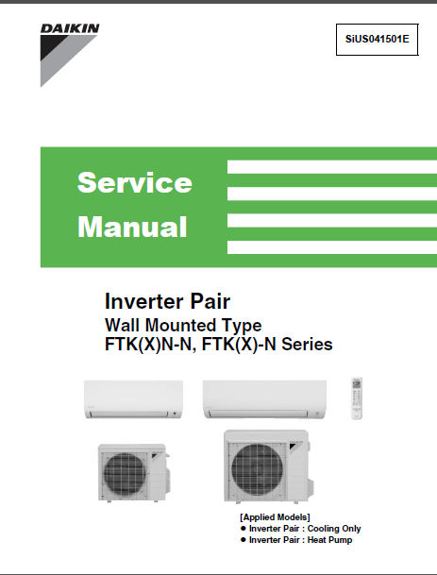
Introduction
Ductless Troubleshooting & Service
Overview
Consult Service Manual
General system problems
Errors indicated at indoor & outdoor units
Error codes – displayed on remote controllers

Slide 4
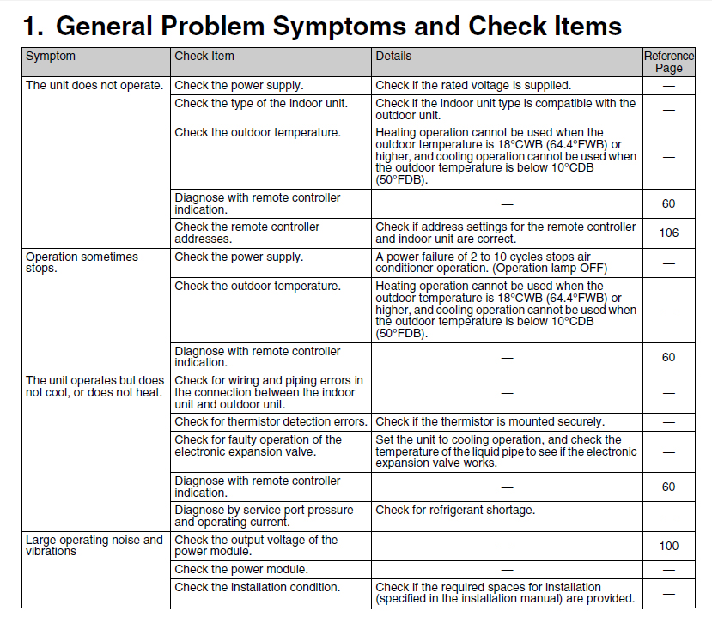
General System Problems
Ductless Troubleshooting & Service
Troubleshooting chart
Service manual should have a symptom/check chart for general problems

Slide 5
General System Problems
Ductless Troubleshooting & Service
System does not run
Some possible causes:
Power supply is off
Improper power supply voltage
Improper wire connection
Mismatched indoor unit and outdoor unit
Low or dead battery in remote controller
Invalid address setting
Transmission error between indoor unit and outdoor unit (defective PCB on outdoor unit)

Slide 6
General System Problems
Ductless Troubleshooting & Service
System runs but does not cool or heat
Some possible causes:
Incorrect temperature setting
Mismatched indoor and outdoor units
Blocked air filter
Insufficient power
Refrigerant piping is too long
Thermistor detection errors
Faulty operation of EEV
Refrigerant shortage and/or refrigerant leak*
*In case of leakage into a room, ventilate
the room immediately

Slide 7
General System Problems
Ductless Troubleshooting & Service
When operation starts, safety breaker trips
Some possible causes:
Insufficient capacity of safety breaker
Ground leakage breaker is too sensitive
Supply voltage is not within rated voltage
Size of connecting wire is too small (indoor power supply unit)
Air is mixed with refrigerant (over filling)
Damaged outdoor unit PCB

Slide 8
General System Problems
Ductless Troubleshooting & Service
Indoor unit makes a loud noise and vibrates
Some possible causes:
Piping length is too short
Mounting wall is too thin
Deformation of the unit
Improper quantity of refrigerant
Incorrect output voltage of power module

Slide 9
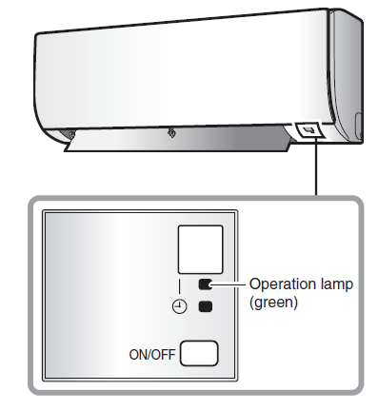
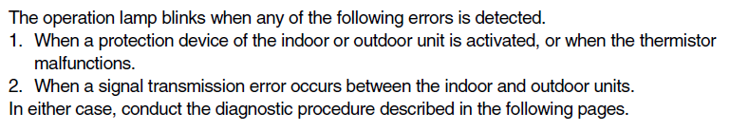
Indoor Unit Indicator
Ductless Troubleshooting & Service
LED lamp or display
Most Daikin indoor units have an LED lamp that will blink if one of several specific errors are detected; consult service manual
Some manufacturers’ indoor units have LED displays that will indicate error codes related to the indoor unit.
Example Indoor LED Lamp

Slide 10
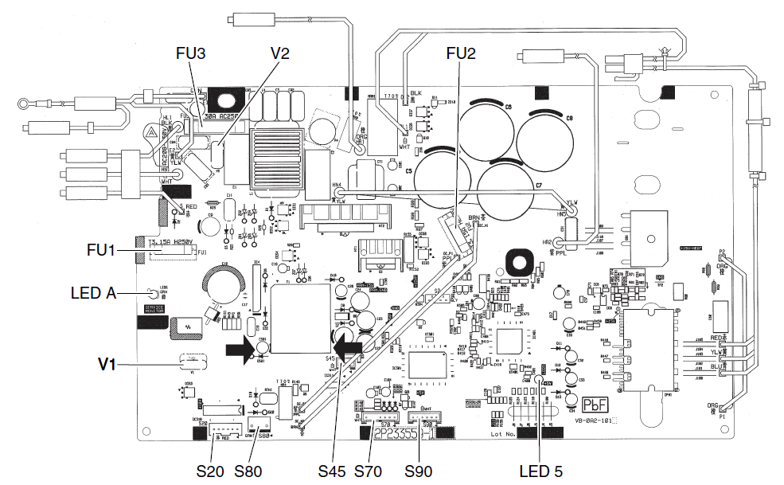
Outdoor Unit Indicator
Ductless Troubleshooting & Service
LED lamp or display
Most Daikin outdoor units have an LED on the PCB that indicates whether the unit is operating correctly
Some manufacturers’ outdoor units have LED displays that will indicate error codes related to the outdoor unit.
Service Monitor LED
Example - Outdoor PCB Service Monitor LED

Slide 11
Error Codes
Ductless Troubleshooting & Service
Error codes displayed on remote controller
sssssssssss

Slide 12
Error Codes
Ductless Troubleshooting & Service
Error Code U4 (Daikin systems)
Communication error between outdoor unit and indoor unit(s)
Data sent from outdoor unit is not received by indoor unit without error, or disabled status of signal transmission continues for 15 seconds and status repeats 3 times
Some possible causes:
Defective outdoor unit PCB
Defective indoor unit PCB
Signal transmission error between indoor and outdoor unit due to improper wiring
Signal transmission error due to breaking of relay wire (transmission wire)
Troubleshooting flow chart provided in service manual
Notes:
When there is a communication malfunction between the outdoor unit and indoor unit(s), the U4 error code displays.
This error is triggered when data from the outdoor unit is not received by the indoor unit without error, or disabled status of signal transmission continues for 15 seconds and this status repeats 3 times.
Possible causes include:
Defective outdoor unit PCB
Defective indoor unit PCB
Signal transmission error due to improper wiring
Breaking of relay wire (transmission wire.

Slide 13
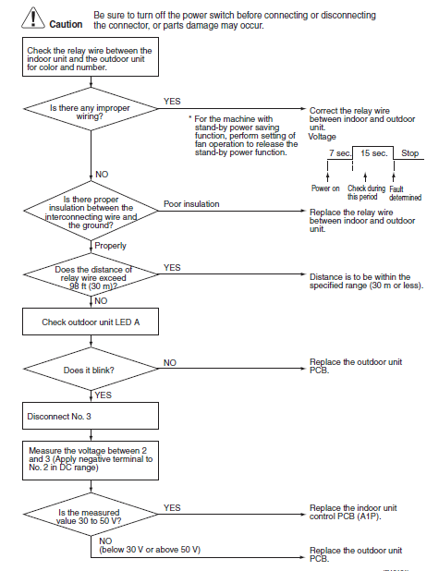
Error Codes
Ductless Troubleshooting & Service
Error Code U4 – cont.
Troubleshooting flow chart provided in service manual
Notes:
A flowchart is provided in the service manual to troubleshoot this code.

